Slide 1

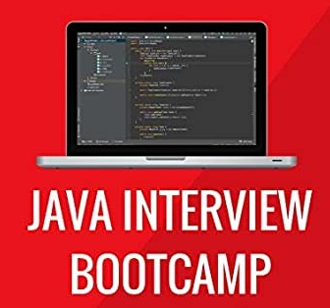
JAVA INTERVIEW BOOTCAMP
Lecture 2

Slide 2

Today’s Agenda
The Java Market
What Company Expects From A Java Developer ?
Most Important Properties Of Java
What You Should Know About These Properties For Interview ?
Popular Interview Questions

Slide 3
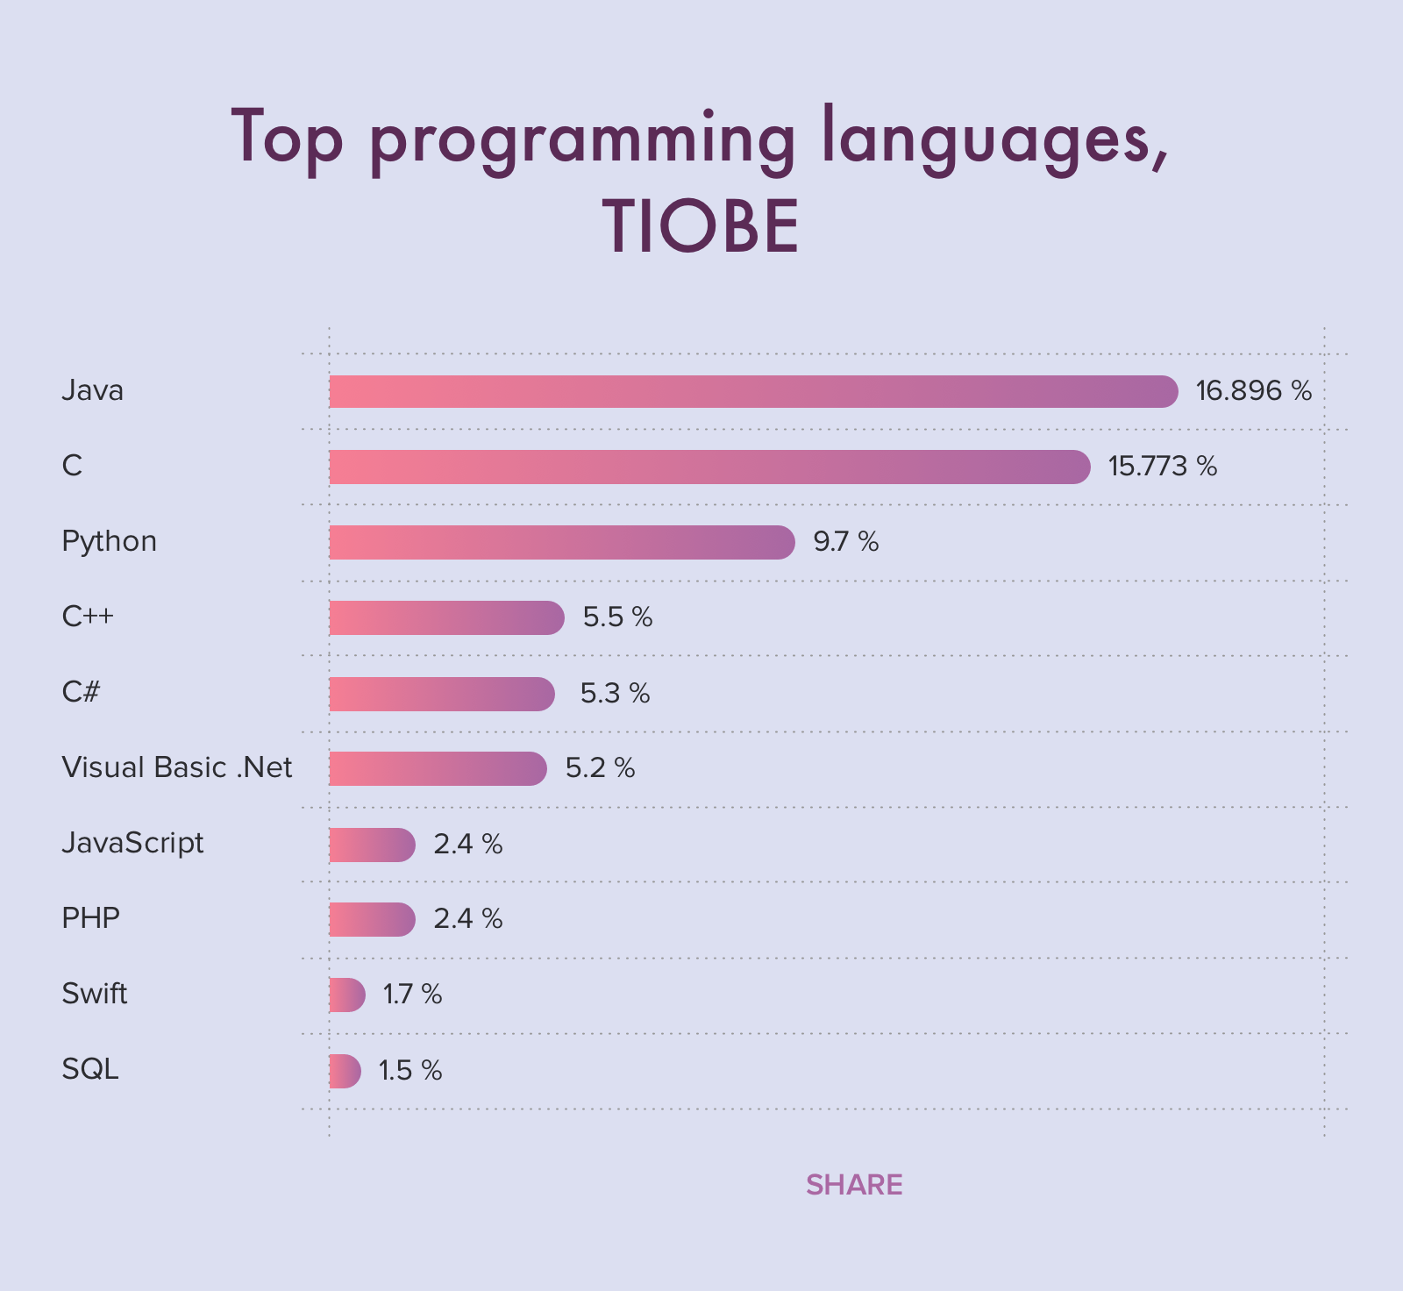
The Java Market
Rated as No 1 Popular Programming language in 2020
Runs on 15 Billion devices worldwide
Used by 10 Million developers for developing web app, enterprise app, mobile app and almost any kind of app.
JAVA IS EVERYWHERE
https://www.cleveroad.com/blog/programming-languages-ranking

Slide 4
What Industry Expects From A Java Developer ?
We can put the above question differently as : How much Java do I need to know for getting a job ?
The one and only answer to this is you must have thorough understanding of CORE JAVA for getting hired by any Top Java Based Companies .
The most authentic answer to this is at :
https://www.quora.com/How-much-Java-do-you-need-to-know-to-get-a-job

Slide 5
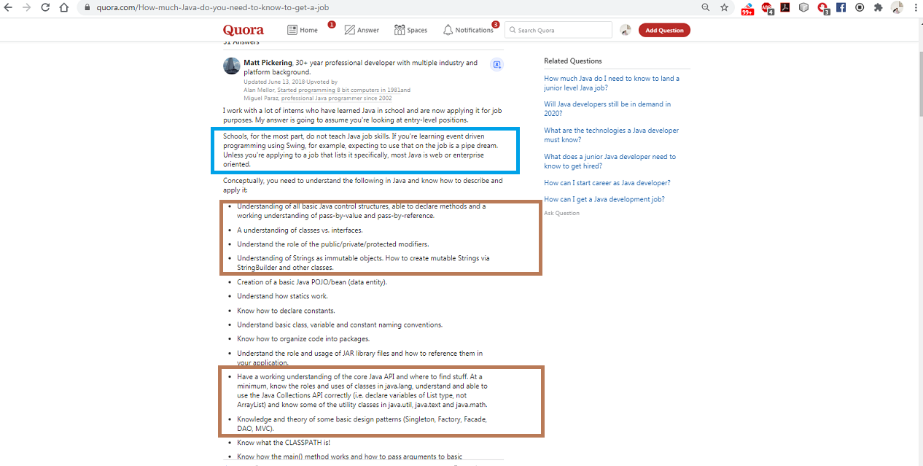
What Industry Expects From A Java Developer ?

Slide 6
Important Properties Of Java For Interview
Simple
Strongly Typed
Multithreaded
Dynamic
Networked
Secure
High Performance
Platform Independent
Portable
Architecture Neutral
Compiled as well as Interpreted
Automatic Memory Management
Object Oriented
Robust

Slide 7
Important Properties Of Java For Interview
1. PLATFORM INDEPENDENCE:
This feature is one of main reasons of Java’s phenomenal rise since its release.
It’s also referred to as “write once, run anywhere” (WORA)—a slogan created by Sun MicrosystemsTM to highlight Java’s platform independence.
Java code can be executed on multiple systems without recompilation.

Slide 8
How Java Achieves Platform Independency ?
Java code is compiled into bytecode, to be executed by a virtual machine—the Java Virtual Machine (JVM).
A JVM is installed on platforms with different OSs like Windows, Mac, or Linux.
A JVM interprets bytecodes to machine-specific instructions for execution.
The implementation details of a JVM are machine-dependent and might differ across platforms, but the bytecode generated by a Java compiler is same across all the platforms

Slide 9
Popular Interview Question
Can we say that Java is Platform Independent but JVM is Platform Dependent ?
Answer:
Yes

Slide 10
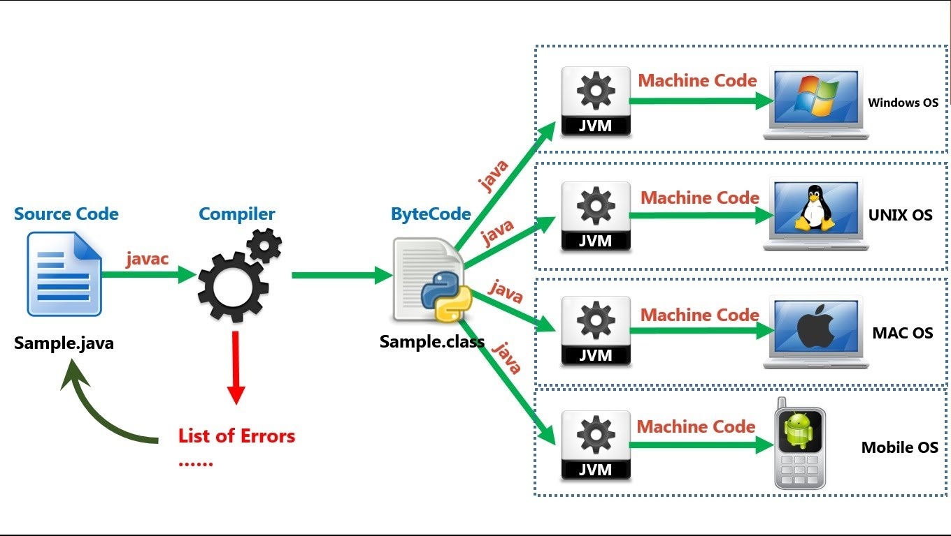
How Java Achieves Platform Independency ?

Slide 11
Important Properties Of Java For Interview
2. PORTABLE
Porrtability is the ability to be easily carried or moved.
In programming, the term Portability represents the ability of software to be transferred from one platform to another.
Almost all high level languages such as C, C++, Java etc are portable i.e. their applications can be executed on all platforms.

Slide 12
How A Language Is Made Portable ?
A language is made portable by providing its compilers or runtime environments for all the platforms.
For ex: C is portable because its compilers are available for all the platforms such Windows, Unix, Mac etc.
Similarly Java is portable because its runtime environment i.e. JRE is available for all the platforms.

Slide 13
Portable V/s Platform Independence
If a language is portable it means that it’s applications can be executed on all platforms, although this will require recompilation of the source code for that platform.
If a language is platform independent then it means that the compiled code without any change can be executed on any platform.

Slide 14
Examples
Based on portability and platform independency languages can be categorized into 3 types:
Portable but not platform independent:
Ex →C/C++
Portable as well as platform independent:
Ex→ Java, Python
Non Portable as well as non platform independent: Ex→Visual Basic

Slide 15
Popular Interview Question
Which statement is true about Java bytecode ?
A. It can run on any platform
B. It can run on any platform only if it is compiled for that platform
C. It can run on any platform that has a JRE
D. It can run on any platform that has a Java compiler
E. It can run on any platform that has both Java compiler and a JRE
Correct Answer:
C

Slide 16
Popular Interview Question
Which two statements are true?
A. Java is platform independent but JVM is platform dependent
B. Java is platform dependent but JVM is platform independent
C. Java bytecode is platform dependent but JVM is platform independent
D. Java bytecode is platform independent but JVM is platform dependent
Correct Answer:
A & D

Slide 17
Important Properties Of Java For Interview
3. ARCHITECTURE NEUTRAL:
Generally Architecture is in regards to hardware, for example 32bit/64bit processors .
A Language or Technology is said to be Architectural neutral if its compiled code can run on any available processors in the real world without reconsidering their development and compilation.

Slide 18
Important Properties Of Java For Interview
Java has this feature because the byte code is independent of the underlying platform that the program is running on.
For example, it doesn't matter if our operating system is 32-bit or 64-bit, the Java byte code is exactly the same.
We don't have to recompile our Java source code for 32-bit or 64-bit.

Slide 19
Important Properties Of Java For Interview
4. COMPILED & INTERPRETED
Unlike most of the programming languages which are either complied or interpreted, Java is both compiled and interpreted .
The Java compiler translates a java source file to bytecodes and the Java interpreter executes the translated byte codes directly on the system that implements the Java Virtual Machine.

Slide 20
Important Properties Of Java For Interview
5. AUTOMATIC MEMORY MANAGEMENT
In traditional programming language like C, C++ , the programmer has to manage memory by allocating and de-allocating memory which leads to memory leaks in the program.
In Java, memory management is taken care by the GC and is safe from memory crashes.
All the allocation and clean up of the memory is done automatically.

Slide 21
Popular Interview Question
What is the heap size that JVM uses ?
Correct Answer:
JVM uses 1/64 of physical memory as Initial heap size
and ¼ of physical memory as Maximum heap size

Slide 22
Important Properties Of Java For Interview
6. OBJECT ORIENTED
Java is an OOPL that supports the construction of programs that consist of collections of collaborating objects.
These objects have a unique identity and can support all important principles of OOP like:
Encapsulation
Polymorphism
Inheritance
Abstraction

Slide 23
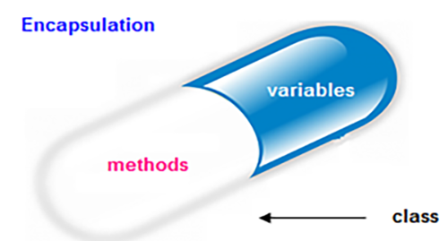
Important Properties Of Java For Interview
What Is Encapsulation ?
Encapsulation is one of the fundamental OOP concepts and it is a mechanism of wrapping up of the data (variables) and code acting on the data (methods) together as a single unit.

Slide 24
Important Properties Of Java For Interview
How Encapsulation Is Achieved ?
The whole idea behind encapsulation is to hide our data in order to make it safe from any modification
We can achieve encapsulation in Java by:
Declaring the variables of a class as private.
Providing public methods to modify and view the variables values.

Slide 25
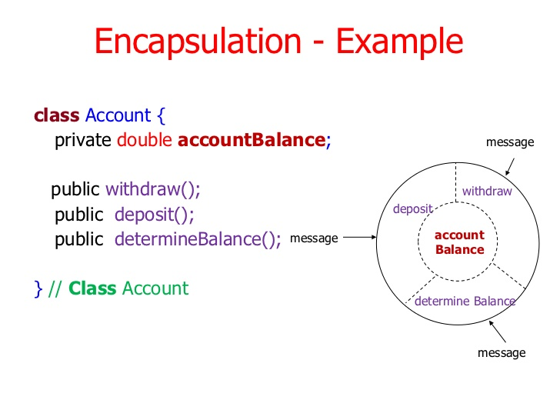
Important Properties Of Java For Interview
How Encapsulation Is Achieved ?

Slide 26
Important Properties Of Java For Interview
Benefits Of Encapsulation ?
Encapsulation is useful in hiding the data(instance variables) of a class from an illegal direct access.
Encapsulation also helps us to make a flexible code which is easy to change and maintain.

Slide 27
Important Properties Of Java For Interview
What Is Polymorphism ?
Polymorphism is derived from 2 greek words called 'poly' and 'morphs'. The word poly means many and morphs mean behavior or form.
Poly + Morphs
↓ ↓ many behavior or form = many behavior In other words if an entity can show different behaviors in different circumstances then it is called Polymorphism.

Slide 28

Important Properties Of Java For Interview

Slide 29
Important Properties Of Java For Interview
How Is Polymorphism Achieved?
To achieve Polymorphism in Java we have 2 options:
Method Overloading: a feature that allows a class to have more than one method having the same name, with different argument lists
Method Overriding: Redefining a method in sub class which is already present in parent class is known as method overriding.

Slide 30
Important Properties Of Java For Interview
Example Of Method Overloading
class OvldDemo {
public void disp(char c)
{
System.out.println(c);
}
public void disp(char c, int num)
{
System.out.println(c + " "+num);
}
}
class Sample {
public static void main(String args[]) {
OvldDemo obj = new OvldDemo();
obj.disp('a');
obj.disp('a',10);
}
}

Slide 31
Important Properties Of Java For Interview
Example Of Method Overriding
class Doctor{
public void treatPatient()
{
............
}
}
class Surgeon extends Doctor{
public void treatPatient()
{
............
}
}
class Sample{
public static void main (String args[]){
Doctor obj= new Doctor()
obj.treatPatient();
// treatPatient method in class //Doctor will be executed
obj= new Surgeon();
obj.treatPatient();
// treatPatient method in class
//Surgeon will be executed
}
}

Slide 32
Important Properties Of Java For Interview
Benefits Of Polymorphism ?
Simplicity The code becomes easier to use and understand
Extensibility It allows functionality of the code to be extended

Slide 33
Important Properties Of Java For Interview
What Is Inheritance?
Inheritance can be defined as the procedure or mechanism of acquiring all the properties and behavior of one class to another.
That is, acquiring the properties and behavior for a child class from the parent class.

Slide 34
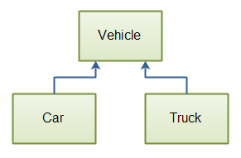
Important Properties Of Java For Interview
What Is Inheritance?
This concept was built in order to achieve the advantage of creating a new class that gets built upon an already existing class.

Slide 35
Important Properties Of Java For Interview
How Is Inheritance Achieved?
To apply inheritance we can create new classes with some extra functionality from an existing class or interface.
When we inherit a class we use the keyword extends and when we inherit an interface we use the keyword implements

Slide 36
Important Properties Of Java For Interview
class B extends A { ….. }
A super class
B sub class
A
<<class>>
<<class>>
B
A
<<interface>>
class B implements A { ….. }
A interface
B sub class
B
<<class>>

Slide 37
Important Properties Of Java For Interview
Benefits Of Inheritance ?
Reusability: Facility to use public methods of base class without rewriting the same.
Reduced Code Redundancy:Another key benefit of inheritance is to minimize the amount of duplicate code in an application by sharing common code amongst several subclasses.

Slide 38
Important Properties Of Java For Interview
What Is Abstraction ?
Abstraction is a process of hiding the implementation details and showing only the required functionality to the user.
In other words we can say, it shows only important things to the user and hides the internal details .

Slide 39
Important Properties Of Java For Interview
What Is Abstraction ?
For example , while chatting on WhatsApp, we just type the text and send the message.
We don't know the internal processing about the message delivery.
Abstraction lets us focus on what the object does instead of how it does it.

Slide 40
Important Properties Of Java For Interview
How Is Abstraction Achieved In Java?
When we conceptualize a class
When we write an ‘interface’
When we write an ‘abstract’ class, method

Slide 41
Important Properties Of Java For Interview
How Is Abstraction Achieved In Java?
class Num
{
public static int sum(int n){
int total=0;
/* logic to calculate sum of
nos from 1 to n */
return total;
}
}
class UseNum
{
public static void main(String [] args)
{
System.out.println(Num.sum(10));
}
}
}
The logic to calculate sum can be implemented in any way like looping ,recursion or mathematical formula . The caller is not required to worry about that . It just knows it has to call method sum( ) to get the sum of nos from 1 to n

Slide 42
Important Properties Of Java For Interview
How Is Abstraction Achieved In Java?
/* A Collection represents a mutable set of elements. */
interface Collection {
/* Add an element. */
void add(Object elem);
/* Remove an element if it is in the group. */
void remove(Object elem);
/* Return true if elem is in the group. */
boolean contains(Object elem);
/* Return the number of elements in the group. */
int size();
}
This Java interface says nothing about the representation or implementation of the collection: it is just an interface. The interface also says nothing about how to create a collection; it merely defines instance operations that can be performed on a collection.

Slide 43
Important Properties Of Java For Interview
Benefits Of Abstraction ?
Abstraction makes code as readable and more simpler. because complexity of code will be hidden.
Abstraction allows us to make internal changes to the code without disturbing outside logic

Slide 44
Important Properties Of Java For Interview
7.ROBUST:
Robust simply means Strong or Fault Tolerant .
Java has very strict rules which every program must compulsorily follow and if these rules are violated then JVM kills/terminates the code by generating “Exception”

Slide 45
Important Properties Of Java For Interview
8.SIMPLE:
Java is easy to learn and its syntax is quite simple, clean and easy to understand.
The confusing and ambiguous concepts of C++ are either left out in Java or they have been re-implemented in a cleaner way.
Ex : Pointers and Operator Overloading are not there in Java but were an important part of C++.

Slide 46
Important Properties Of Java For Interview
9.STRONGLY TYPED:
Java is a strongly typed programming language because every variable must be declared with a data type.
A variable cannot start off life without knowing the range of values it can hold, and once it is declared, the data type of the variable cannot change.

Slide 47
Important Properties Of Java For Interview
The variable name has been declared as String , so it can only hold Strings
For Example ( In java):
String name=“Sachin”;
name=25;
For Example ( In python):
name=“Sachin”
name=25
ERROR! This will not compile as we are trying to assign an int to a String and Strongly typed languages do not allow this
The variable name has been assigned a string value and data type is implicitly set to string
PERFECTLY OK! Because python is a weakly/dynamically typed language so now name will be an integer

Slide 48
Important Properties Of Java For Interview
10. MULTITHREADED:
Java’s multithreading feature makes it possible to write programs that can do many tasks simultaneously.
Benefit of multithreading is that it utilizes same memory and other resources to execute multiple threads at the same time.

Slide 49
Important Properties Of Java For Interview
11. DYNAMIC:
In terms of programming language the dynamic refers to the things which are executed as and when required , rather than in advance.
In Java it means that when we use a class in our program then Java does not loads it at program startup ,rather ,at runtime, the JRE searches and loads the class.

Slide 50
Important Properties Of Java For Interview
The class Date will not be loaded at program startup rather it will be loaded when it is required
class Test{
public static void main(String [] args){
………………..
………………..
………………..
………………..
Date d=new Date();
……………..
……………..
Scanner kb=new Scanner(System.in);
………….
………….
}
Similarly the class Scanner also will not be loaded at program startup but only when this line is executed

Slide 51
Important Properties Of Java For Interview
12. NETWORKED:
No language can compete Java in networking support.
Java supports both LAN programming (TCP/IP and UDP) , Internet Programming and distributed programming.

Slide 52
Important Properties Of Java For Interview
Java includes sockets and server sockets to support socket (LAN) programming (with java.net package)
Servlets and JSP (with javax.servlet.http package) for Internet-based programming
RMI(with java.rmi ) to support distributed programming..

Slide 53
Important Properties Of Java For Interview
What is Distributed Programming / Computing ?
A distributed system in its most simplest definition is a group of computers working together as to appear as a single computer to the end-user.
That is , different parts of the same program run on different computers over a network.

Slide 54
Important Properties Of Java For Interview
In Java , this is made possible by a technique called RMI(Remote Method Invocation)
RMI allows a method that is running on one computer to call a method in an object that is on another computer.
Benefits: Programmers working on same project may not be required to be physically present at the same location

Slide 55
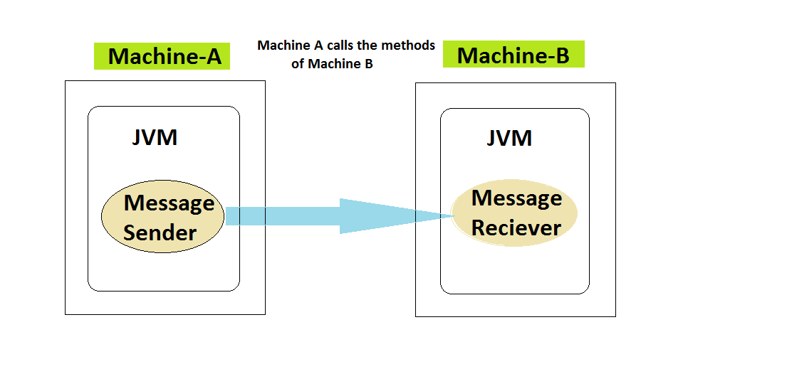
Important Properties Of Java For Interview

Slide 56
Important Properties Of Java For Interview
13. SECURE:
Java does not use pointers explicitly.
Moreover all the programs in Java are run under an area known as the sand box.
This sandbox uses a bytecode verification process to ensure that code loaded does not violate Java security constraints

Slide 57
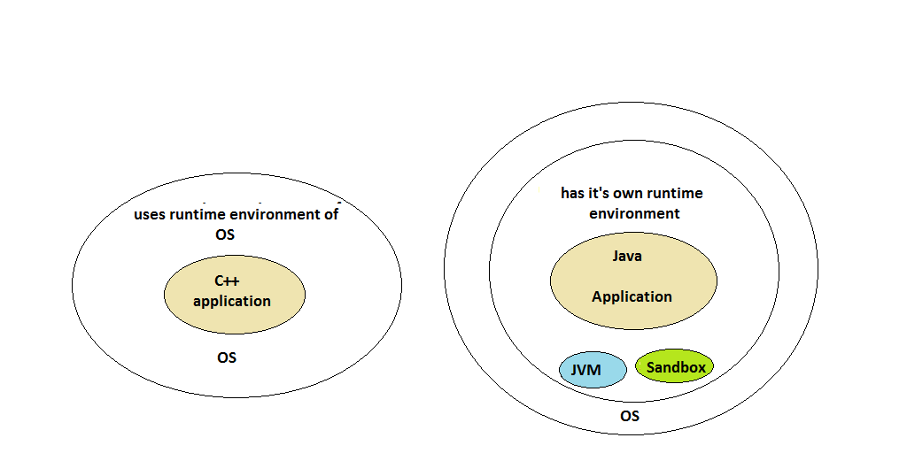
Important Properties Of Java For Interview

Slide 58
Important Properties Of Java For Interview
14. HIGH PERFORMANCE:
Although Java is an interpreted language, and it originally had only an interpreter inside JVM .
But later on it was re-designed to support JITC (just-in-time compilers) , which dynamically compile bytecodes to machine code.
Due to this , Java gives high performance as compared to other interpreted languages

